Slide 1
Interior Designing using AR
Team Name: InterLock
Name : Abin O Varghese
www.abinovarghese.com

Slide 2
Why AR?
Improved Customer Experience
“Feel” before “buy”
Real time aesthetic design

Slide 3
What if customer can do more?
One of the major plus point of AR is the customer can have an interactive experience with the interior design of the room.
But why limit the customer to select a prefilled set of 3d objects when we can do more?

Slide 4
Changing Specification
Yes! That’s the Idea. What if the customer change the specification that suits the room and what if customer can experience in real time the customization?
Not all specification can be changed but we do can change some. So the next big question was what specifications will be apt for this adaptation?
The major achievement of AR in this field is that customer get the look and fell of the design they are planning to implement and what more is more related to this that the COLOR and TEXTURE of the furniture? And hence this APP

Slide 5
Options
This APP is build on top of google’s AR Core and in addition to the option to place/remove the 3d objects of furniture’s in an AR environment we give the user the following options:
Change the colour of the object from a colour picker included.
Change the Texture of the object by changing two parameters called as Metallic Factor and Roughness Factor.

Slide 6
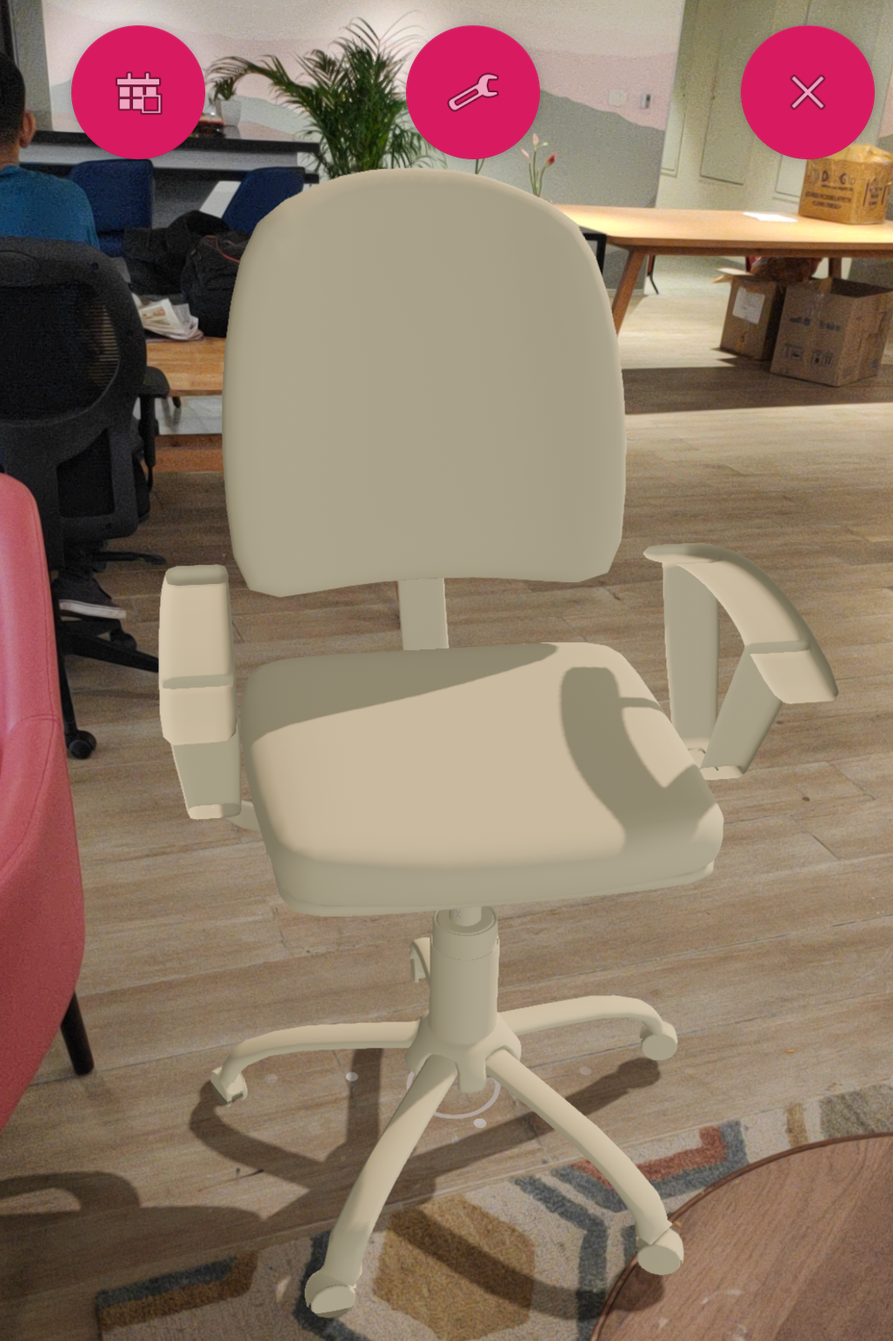
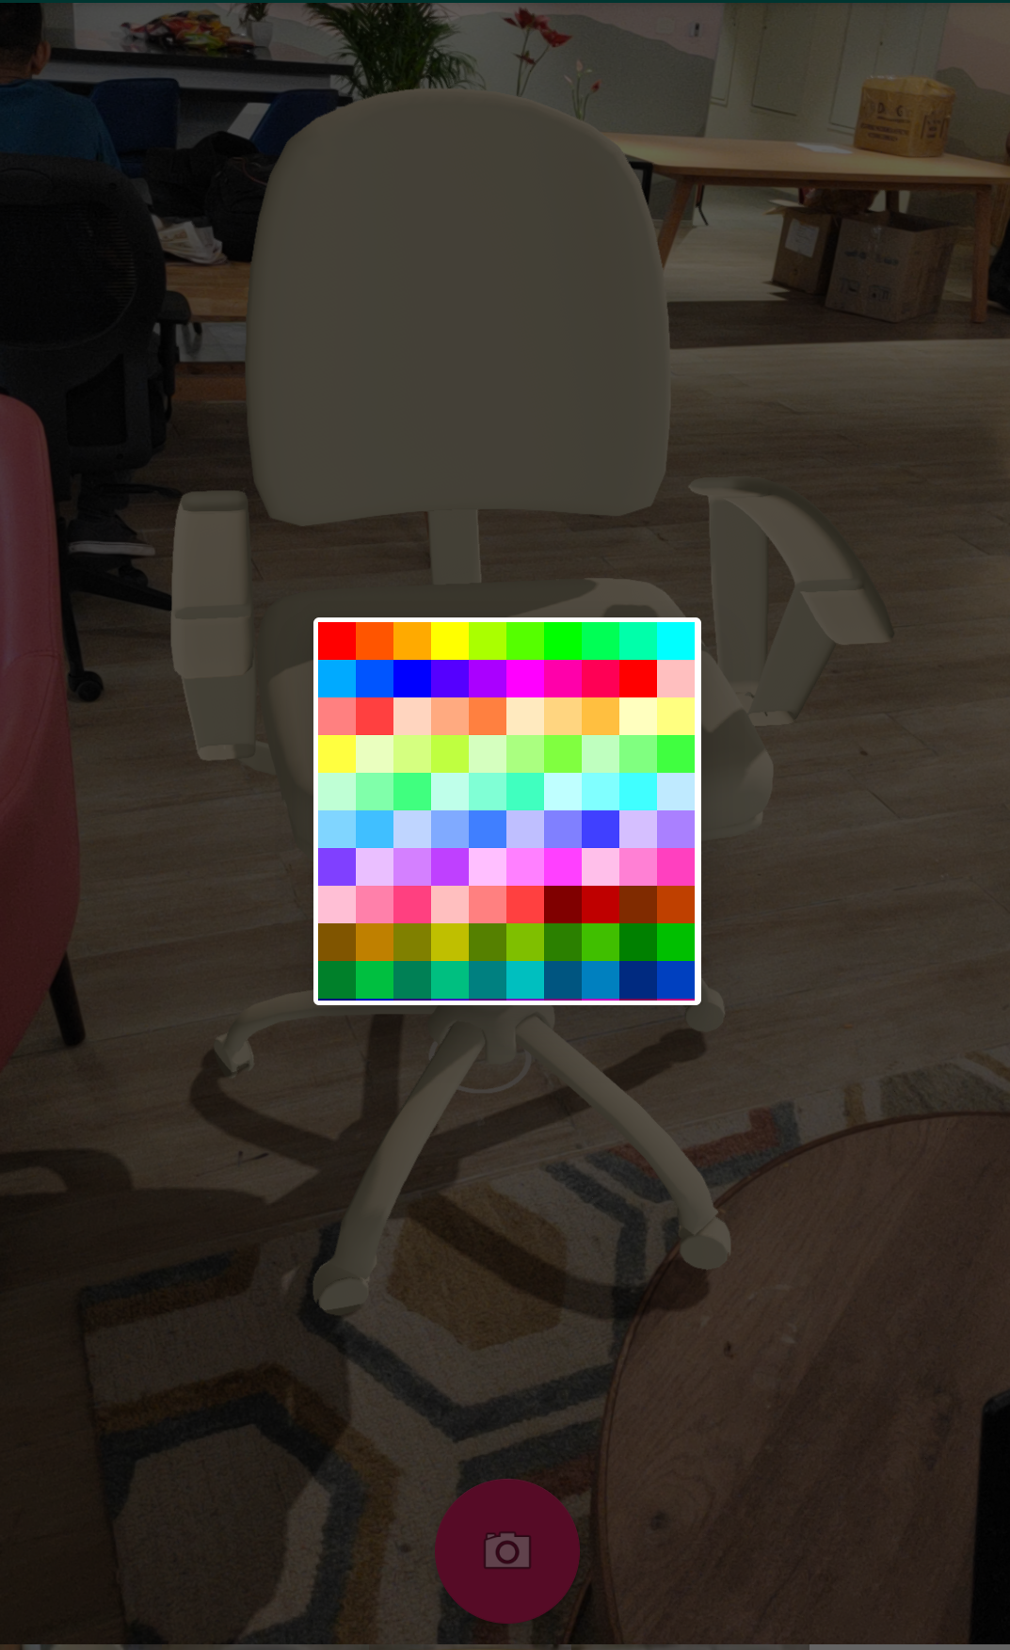
Main UI

Slide 7
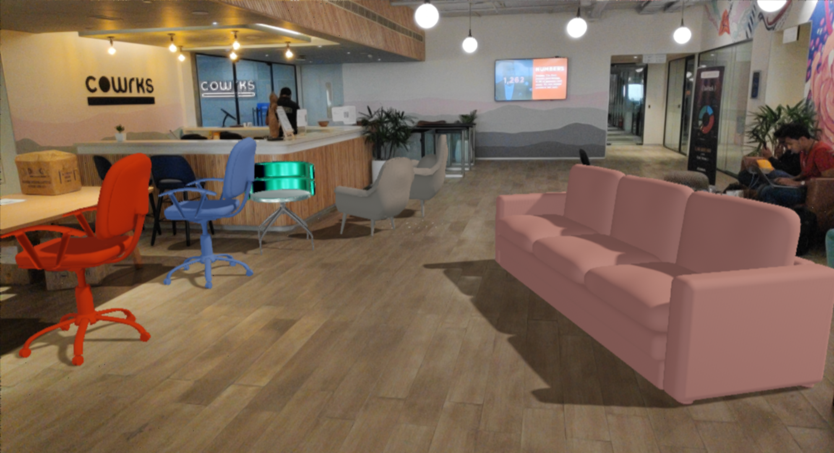
Image Captures

Slide 8
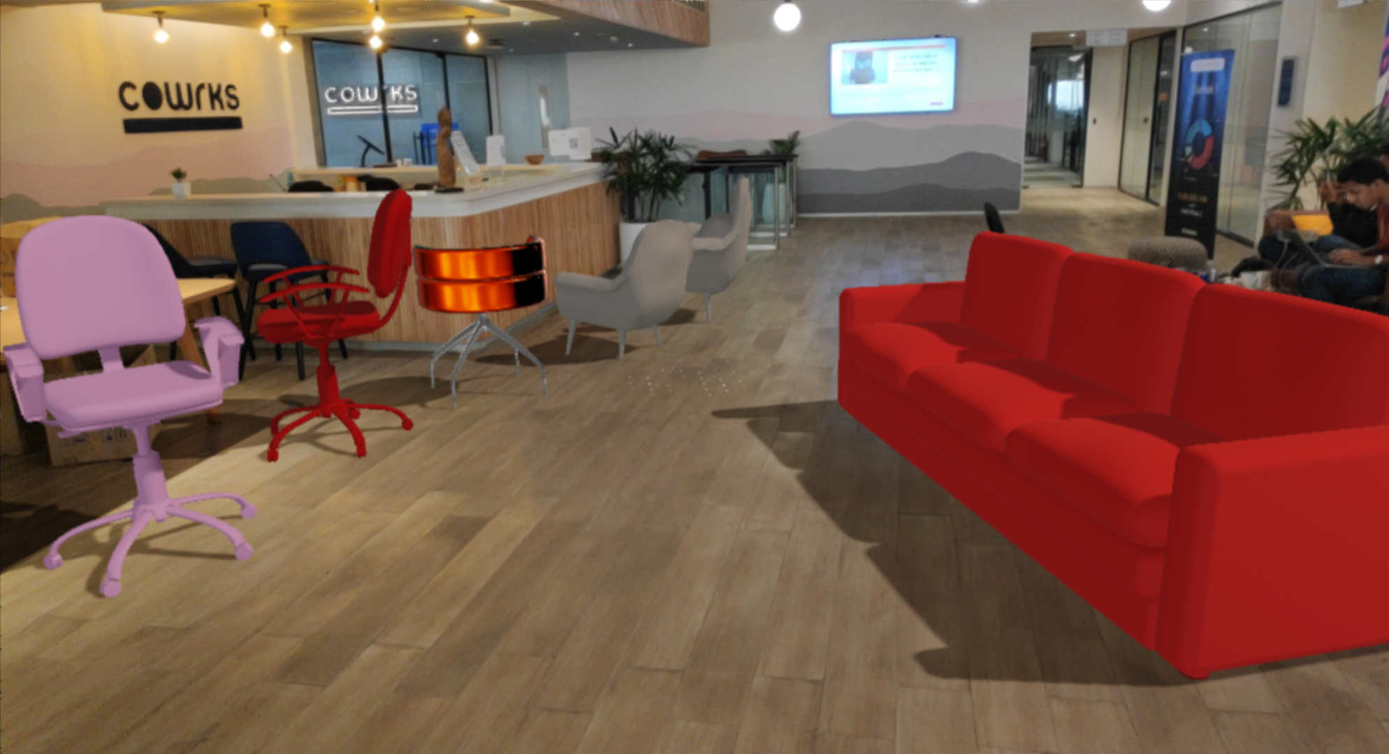

Slide 9
Thank YoU!

